Slide 1

Diamond Price Prediction
DSC 680 - Project #2
Author: Era Ebhodaghe
Date: November 1, 2025

Slide 2
Introduction
Machine learning regression models were applied to predict diamond prices using the Diamonds Dataset.
The study analyzed relationships between diamond characteristics (carat, cut, color, clarity) and market prices.
Goal: Develop accurate predictive models to support jewelers and online retailers with data-driven pricing.

Slide 3
Business Problem
Traditional valuation methods rely on subjective human judgment.
Price inconsistencies arise from varying quality interpretations and market fluctuations.
Machine learning offers standardized, consistent, and data-driven appraisal solutions.

Slide 4
Background and History
Diamond pricing is based on the Four Cs: Carat, Cut, Color, and Clarity.
Manual grading introduces variation and bias.
Predictive modeling helps quantify and standardize the effect of each factor on price.

Slide 5
Data Explanation
Dataset: 53,000+ diamonds from Kaggle.
Features: Carat, Cut, Color, Clarity, x, y, z, Price.
Preprocessing: Duplicates removed, categorical variables encoded, log transformation applied on price.
Feature Engineering: Added 'volume = x × y × z'.

Slide 6
Methods
Models used: Linear Regression, Random Forest, Gradient Boosting, XGBoost.
Metrics: MSE, MAE, R², Accuracy (within 10%).
XGBoost tuning via RandomizedSearchCV for best parameters.
Tools: Python, pandas, scikit-learn, seaborn, matplotlib.

Slide 7
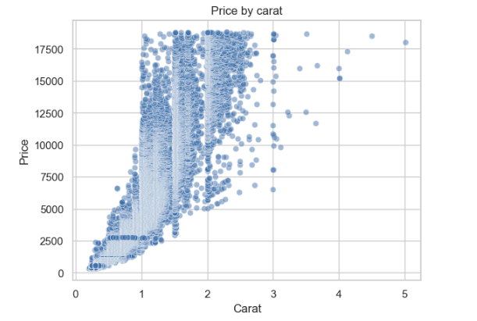
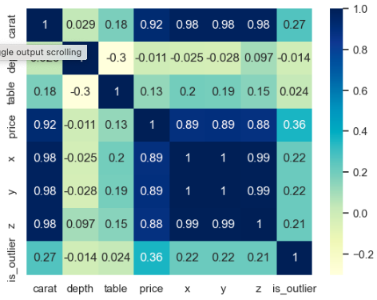
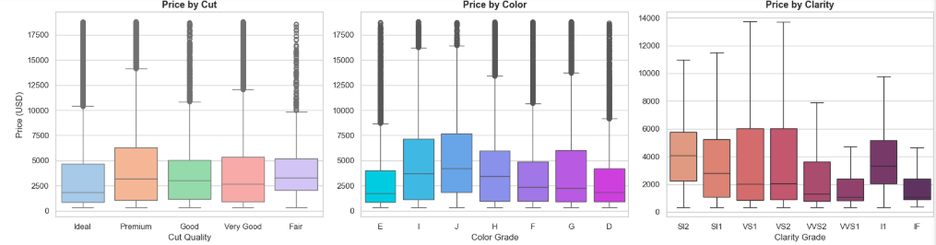
Analysis
Carat and volume strongly correlated with price.
Cut, color, and clarity showed moderate effects.
Figure 1: Price vs Carat
Figure 2: Correlation Heatmap
Figure 3: Price by Cut/Color/Clarity

Slide 8
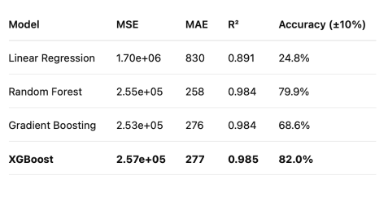
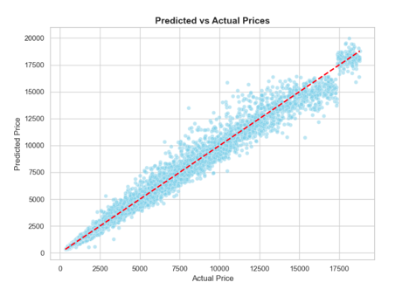
Analysis
XGBoost achieved best results (R² = 0.985, 82% accuracy within ±10%).
Figure 4: Performance of all models
Figure 5: Predicted vs Actual Prices (XGBoost)

Slide 9
Conclusion
Machine learning models can accurately predict diamond prices.
XGBoost provided the best balance of accuracy and interpretability.
Applications: Pricing automation, valuation standardization, and transparency improvement.

Slide 10
Assumptions and Limitations
Assumptions: Stable market, representative dataset, meaningful label encoding.
Limitations: Missing features (fluorescence, symmetry), limited price range, no market trend inclusion.

Slide 11
Challenges
Data skew and invalid entries required cleaning.
Hyperparameter tuning demanded significant computation.
Balancing interpretability and predictive power remained difficult.

Slide 12
Future Uses & Recommendations
Expand to real-time pricing and online appraisal tools.
Retrain models regularly to reflect market changes.
Include new features for improved accuracy (e.g., fluorescence).
Use SHAP or similar tools for explainable AI in business applications.

Slide 13
Implementation Plan
Develop a web-based interface for real-time predictions.
Integrate pipeline with trained XGBoost model and scaler.
Retrain every 6 months to maintain accuracy.

Slide 14
Ethical Assessment
Models should improve transparency, not manipulate consumers.
Disclose that ML predictions complement, not replace, professional appraisals.
Ensure compliance with data licensing and fairness principles.

Slide 15
Audience Questions
Why was XGBoost chosen over Random Forest despite similar R² scores?
How does log transformation improve prediction accuracy?
Could the model handle colored or lab-grown diamonds?
How were categorical features (cut, color, clarity) encoded?
What does 82% accuracy within 10% tolerance mean in practice?
How might new features like polish or fluorescence affect results?
What risks exist when using automated appraisal tools online?
Could this model be integrated into online diamond marketplaces?
How can interpretability be improved for non-technical users?
What ethical safeguards should companies adopt when deploying this model?

Slide 16
References
Kaggle (2025). Diamonds Dataset. Retrieved from https://www.kaggle.com/datasets/shivam2503/diamonds
Gemological Institute of America (2024). Diamond 4Cs: The Methodology of Grading and Valuation.

